Slide 1
Chapter Twelve
Network Security
Data Communications and Computer Networks: A Business User’s Approach
Eighth Edition

Slide 2
After reading this chapter, you should be able to:
Recognize the basic forms of system attacks
Recognize the concepts underlying physical protection measures
Cite the techniques used to control access to computers and networks
Discuss the strengths and weaknesses of passwords
List the techniques used to make data secure
Data Communications and Computer Networks: A Business User's Approach, Eighth Edition
© 2016. Cengage Learning. All Rights Reserved.

Slide 3
After reading this chapter, you should be able to (continued):
Explain the difference between a substitution-based cipher and a transposition-based cipher
Outline the basic features of public key cryptography, Advanced Encryption Standard, digital signatures, and the public key infrastructure
Cite the techniques used to secure communications
Describe the differences between the frequency hopping spread spectrum technique and the direct sequence spread spectrum technique
Data Communications and Computer Networks: A Business User's Approach, Eighth Edition
© 2016. Cengage Learning. All Rights Reserved.

Slide 4
After reading this chapter, you should be able to (continued):
Recognize the importance of a firewall and be able to describe the two basic types of firewall protection
Recognize the techniques used to secure wireless communications
List the advantages to a business of having a security policy
Data Communications and Computer Networks: A Business User's Approach, Eighth Edition
© 2016. Cengage Learning. All Rights Reserved.

Slide 5
Introduction
While computer systems today have some of the best security systems ever, they are more vulnerable than ever before
This vulnerability stems from the world-wide access to computer systems via the Internet
Computer and network security comes in many forms, including encryption algorithms, access to facilities, digital signatures, and using fingerprints and face scans as passwords
Data Communications and Computer Networks: A Business User's Approach, Eighth Edition
© 2016. Cengage Learning. All Rights Reserved.

Slide 6
Standard System Attacks
Viruses
  Computer virus – small program that alters the way a computer operates and often does various types of damage by deleting and corrupting data and program files, or by altering operating system components, so that computer operation is impaired or even halted
  Many different types of viruses, such as parasitic, boot sector, stealth, polymorphic, and macro
Data Communications and Computer Networks: A Business User's Approach, Eighth Edition
© 2016. Cengage Learning. All Rights Reserved.

Slide 7
Standard System Attacks (continued)
Worms
  Computer worm – program that copies itself from one system to another over a network, without the assistance of a human being
  Worms usually propagate themselves by transferring from computer to computer via e-mail
Typically, a virus or a worm is transported as a Trojan horse
  In other words, hiding inside a harmless-looking piece of code such as an e-mail or an application macro
Data Communications and Computer Networks: A Business User's Approach, Eighth Edition
© 2016. Cengage Learning. All Rights Reserved.

Slide 8
Standard System Attacks (continued)
Two popular forms of attacks:
  Socially engineered attack – a bogus link in a web page that leads to no good
  Exploiting known vulnerabilities in operating systems and application software
For both of these, software company issues a patch
  Patch may fix it, or introduce even more holes
    Either way, bad guys find new holes and exploit
Data Communications and Computer Networks: A Business User's Approach, Eighth Edition
© 2016. Cengage Learning. All Rights Reserved.

Slide 9
Standard System Attacks (continued)
Very common way to attack vulnerability is via an e-mail attachment
  You open the attachment and you launch the virus
Second common way to attack is to simply scan your computer ports while you are connected to the Internet (either dial-up or non-dial-up)
  If you have an open port, hacker will download malicious software to your machine
Data Communications and Computer Networks: A Business User's Approach, Eighth Edition
© 2016. Cengage Learning. All Rights Reserved.

Slide 10
Standard System Attacks (continued)
Other standard attacks
  Denial of service attacks, or distributed denial of service attacks
    Bombard computer site with so many messages that site is incapable of answering valid request
  E-mail bombing
    User sends an excessive amount of unwanted e-mail to someone
  Botnets
    Malicious programs that take over operations on a comprised computer
Data Communications and Computer Networks: A Business User's Approach, Eighth Edition
© 2016. Cengage Learning. All Rights Reserved.

Slide 11
Standard System Attacks (continued)
Other standard attacks (continued)
  Smurfing
    Nasty technique in which a program attacks a network by exploiting IP broadcast addressing operations
  Ping storm
    Condition in which the Internet ping program is used to send a flood of packets to a server
Data Communications and Computer Networks: A Business User's Approach, Eighth Edition
© 2016. Cengage Learning. All Rights Reserved.

Slide 12
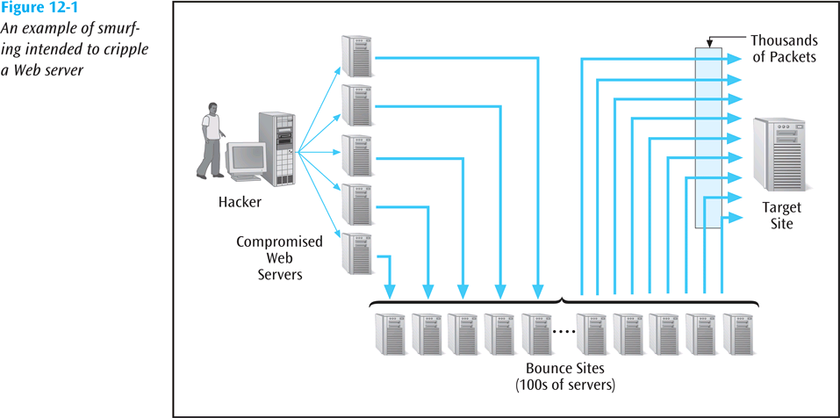
Standard System Attacks (continued)
Data Communications and Computer Networks: A Business User's Approach, Eighth Edition
© 2016. Cengage Learning. All Rights Reserved.

Slide 13
Standard System Attacks (continued)
Other standard attacks (continued)
  Spoofing
    When a user creates a packet that appears to be something else or from someone else
  Trojan Horse
    Malicious piece of code hidden inside a seemingly harmless piece of code.
  Stealing, guessing, and intercepting passwords is also a tried and true form of attack
Data Communications and Computer Networks: A Business User's Approach, Eighth Edition
© 2016. Cengage Learning. All Rights Reserved.

Slide 14
Standard System Attacks (continued)
Other standard attacks (continued)
  Phishing
    Hackers create emails which look as if they are coming from a legit source when in reality the hacker is trying to get the user to give up ID and password info
  Pharming
    Hacker redirects unknowing user to bogus look-alike website
Data Communications and Computer Networks: A Business User's Approach, Eighth Edition
© 2016. Cengage Learning. All Rights Reserved.

Slide 15
Standard System Attacks (continued)
Other standard attacks (continued)
  Rootkit
    A program that has been installed deep within a user’s operating system; defies detection and takes over the user’s computer
  Keylogger
    A software system that secretly captures and records keystrokes made at a user’s keyboard
Data Communications and Computer Networks: A Business User's Approach, Eighth Edition
© 2016. Cengage Learning. All Rights Reserved.

Slide 16
Physical Protection
Protection from environmental damage such as floods, earthquakes, and heat
Physical security such as locking rooms, locking down computers, keyboards, and other devices
Electrical protection from power surges
Noise protection from placing computers away from devices that generate electromagnetic interference
Data Communications and Computer Networks: A Business User's Approach, Eighth Edition
© 2016. Cengage Learning. All Rights Reserved.

Slide 17
Physical Protection (continued)
Surveillance
  Proper placement of security cameras can deter theft and vandalism
  Cameras can also provide a record of activities
  Intrusion detection is a field of study in which specialists try to prevent intrusion and try to determine if a computer system has been violated
  Honeypot is an indirect form of surveillance
    Network personnel create a trap, watching for unscrupulous activity
Data Communications and Computer Networks: A Business User's Approach, Eighth Edition
© 2016. Cengage Learning. All Rights Reserved.

Slide 18
Controlling Access
Deciding who has access to what
Limiting time of day access
Limiting day of week access
Limiting access from a location, such as not allowing a user to use a remote login during certain periods of time
Data Communications and Computer Networks: A Business User's Approach, Eighth Edition
© 2016. Cengage Learning. All Rights Reserved.

Slide 19
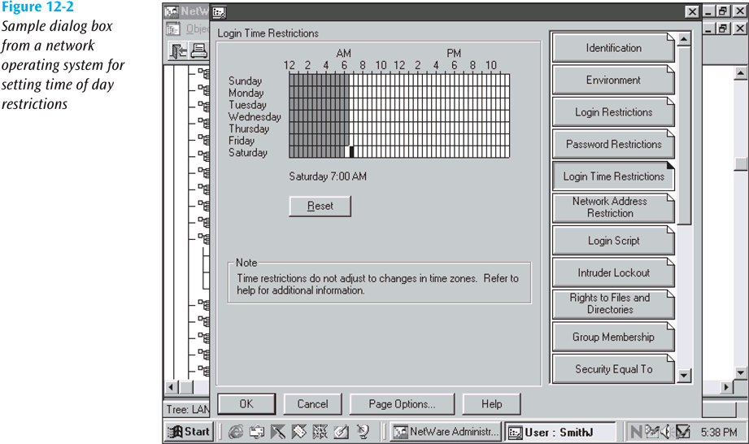
Controlling Access (continued)
Data Communications and Computer Networks: A Business User's Approach, Eighth Edition
© 2016. Cengage Learning. All Rights Reserved.

Slide 20
Passwords and ID Systems
Passwords are the most common form of security and the most abused
Simple rules help support safe passwords, including:
  Change your password often
  Pick a good, random password (minimum 8 characters, mixed symbols)
  Don’t share passwords or write them down
  Don’t select names and familiar objects as passwords
Data Communications and Computer Networks: A Business User's Approach, Eighth Edition
© 2016. Cengage Learning. All Rights Reserved.

Slide 21
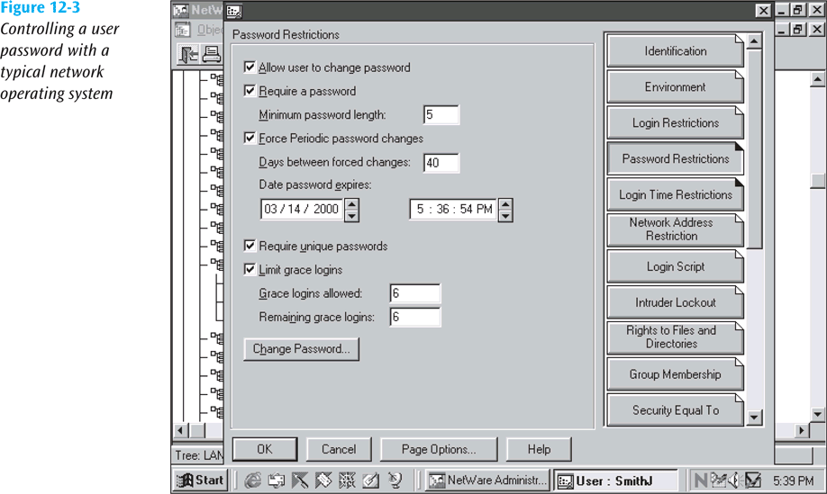
Passwords and ID Systems (continued)
Data Communications and Computer Networks: A Business User's Approach, Eighth Edition
© 2016. Cengage Learning. All Rights Reserved.

Slide 22
Passwords and ID Systems (continued)
Many new forms of “passwords” are emerging (biometrics):
  Fingerprints
  Face prints
  Retina scans and iris scans
  Voice prints
  Ear prints (?)
Data Communications and Computer Networks: A Business User's Approach, Eighth Edition
© 2016. Cengage Learning. All Rights Reserved.

Slide 23
Access Rights
Two basic questions to access rights:
  Who and how?
Who do you give access rights to?
  No one, group of users, entire set of users?
How does a user or group of users have access?
  Read, write, delete, print, copy, execute?
Most network operating systems have a powerful system for assigning access rights
Data Communications and Computer Networks: A Business User's Approach, Eighth Edition
© 2016. Cengage Learning. All Rights Reserved.

Slide 24
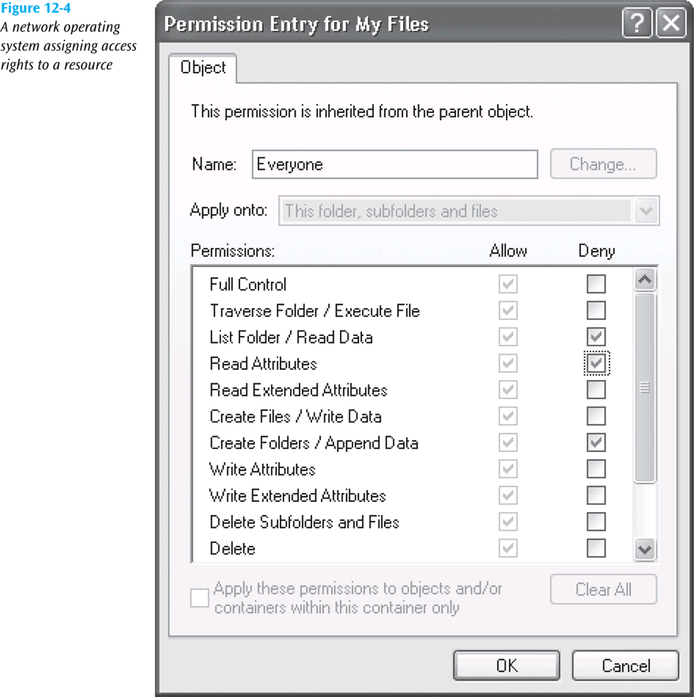
Access Rights (continued)
Data Communications and Computer Networks: A Business User's Approach, Eighth Edition
© 2016. Cengage Learning. All Rights Reserved.

Slide 25
Auditing
Creating a computer or paper audit can help detect wrongdoing
Auditing can also be used as a deterrent
Many network operating systems allow the administrator to audit most types of transactions
Many types of criminals have been caught because of computer-based audits
Data Communications and Computer Networks: A Business User's Approach, Eighth Edition
© 2016. Cengage Learning. All Rights Reserved.

Slide 26
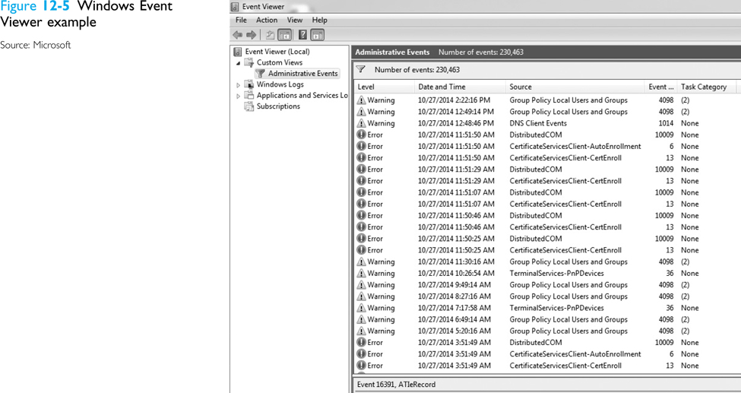
Auditing (continued)
Data Communications and Computer Networks: A Business User's Approach, Eighth Edition
© 2016. Cengage Learning. All Rights Reserved.

Slide 27
Basic Encryption and Decryption Techniques
Cryptography – study of creating and using encryption and decryption techniques
Plaintext – data before any encryption has been performed
Ciphertext – data after encryption has been performed
The key is the unique piece of information that is used to create ciphertext and decrypt the ciphertext back into plaintext
Data Communications and Computer Networks: A Business User's Approach, Eighth Edition
© 2016. Cengage Learning. All Rights Reserved.

Slide 28
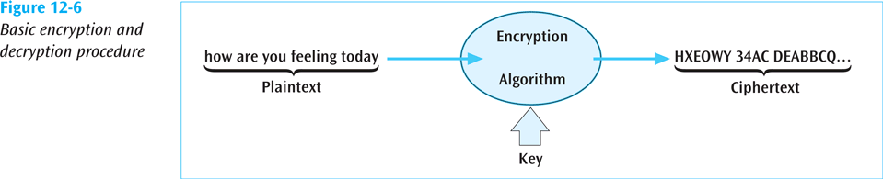
Basic Encryption and Decryption Techniques (continued)
Data Communications and Computer Networks: A Business User's Approach, Eighth Edition
© 2016. Cengage Learning. All Rights Reserved.

Slide 29
Monoalphabetic Substitution-Based Ciphers
Monoalphabetic substitution-based ciphers replace a character or characters with a different character or characters, based upon some key
  Replacing: abcdefghijklmnopqrstuvwxyz
    with: POIUYTREWQLKJHGFDSAMNBVCXZ
  The message: how about lunch at noon
    encodes into: EGVPO GNMKN HIEPM HGGH
Data Communications and Computer Networks: A Business User's Approach, Eighth Edition
© 2016. Cengage Learning. All Rights Reserved.

Slide 30
Polyalphabetic Substitution-Based Ciphers
Similar to monoalphabetic ciphers except multiple alphabetic strings are used to encode the plaintext
Example – matrix of strings, 26 rows by 26 characters or columns can be used
A key such as COMPUTERSCIENCE is placed repeatedly over the plaintext
  COMPUTERSCIENCECOMPUTERSCIENCECOMPUTER
  thisclassondatacommunicationsisthebest
Data Communications and Computer Networks: A Business User's Approach, Eighth Edition
© 2016. Cengage Learning. All Rights Reserved.

Slide 31
Polyalphabetic Substitution-Based Ciphers (continued)
To encode the message, take the first letter of the plaintext, t, and the corresponding key character immediately above it, C
  Go to row C column t in the 26x26 matrix and retrieve the ciphertext character V
Continue with the other characters in plaintext
Data Communications and Computer Networks: A Business User's Approach, Eighth Edition
© 2016. Cengage Learning. All Rights Reserved.

Slide 32
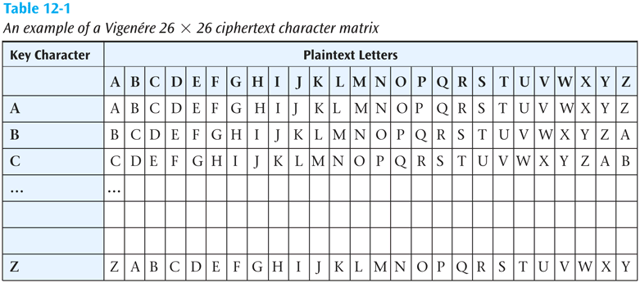
Polyalphabetic Substitution-Based Ciphers (continued)
Data Communications and Computer Networks: A Business User's Approach, Eighth Edition
© 2016. Cengage Learning. All Rights Reserved.

Slide 33
Transposition-Based Ciphers
In a transposition-based cipher, the order of the plaintext is not preserved
As a simple example, select a key such as COMPUTER
  Number the letters of the word COMPUTER in the order they appear in the alphabet
    1 4 3 5 8 7 2 6
    C O M P U T E R
Data Communications and Computer Networks: A Business User's Approach, Eighth Edition
© 2016. Cengage Learning. All Rights Reserved.

Slide 34
Transposition-Based Ciphers (continued)
Now take the plaintext message and write it under the key
  1 4 3 5 8 7 2 6
  C O M P U T E R
  t h i s i s t h
  e b e s t c l a
  s s i h a v e e
  v e r t a k e n
Data Communications and Computer Networks: A Business User's Approach, Eighth Edition
© 2016. Cengage Learning. All Rights Reserved.

Slide 35
Transposition-Based Ciphers (continued)
Then read the ciphertext down the columns, starting with the column numbered 1, followed by column number 2
  TESVTLEEIEIRHBSESSHTHAENSCVKITAA
Data Communications and Computer Networks: A Business User's Approach, Eighth Edition
© 2016. Cengage Learning. All Rights Reserved.

Slide 36
Public Key Cryptography
Very powerful encryption technique in which two keys are used
  First key (the public key) encrypts the message
  Second key (the private key) decrypts the message
Not possible to deduce one key from the other
Not possible to break code given public key
If you want someone to send you secure data, give them your public key, you keep the private key
Secure Sockets Layer on the Internet is a common example of public key cryptography
Data Communications and Computer Networks: A Business User's Approach, Eighth Edition
© 2016. Cengage Learning. All Rights Reserved.

Slide 37
Data Encryption Standard and Advanced Encryption Standard
Created in 1977 and in operation into the 1990s, the Data Encryption Standard took a 64-bit block of data and subjected it to 16 levels of encryption
The choice of encryption performed at each of the 16 levels depends on the 56-bit key applied
Even though 56 bits provides over 72 quadrillion combinations, a system using this standard has been cracked (in 1998 by Electronic Frontier Foundation in 3 days)
Data Communications and Computer Networks: A Business User's Approach, Eighth Edition
© 2016. Cengage Learning. All Rights Reserved.

Slide 38
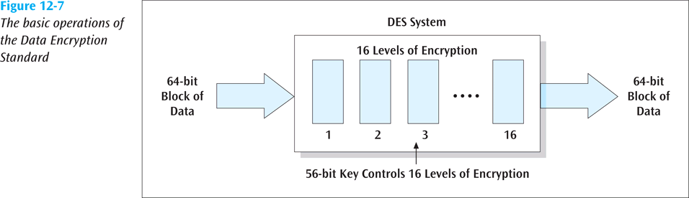
Data Encryption Standard and Advanced Encryption Standard (continued)
Data Communications and Computer Networks: A Business User's Approach, Eighth Edition
© 2016. Cengage Learning. All Rights Reserved.

Slide 39
Data Encryption Standard and Advanced Encryption Standard (continued)
Triple-DES
  More powerful data encryption standard
  Data is encrypted using DES three times:
    First time by the first key
    Second time by a second key
    Third time by the first key again
      Can also have 3 unique keys
  While virtually unbreakable, triple-DES is CPU intensive
  With more smart cards, cell phones, and PDAs, a faster (and smaller) piece of code is highly desirable
Data Communications and Computer Networks: A Business User's Approach, Eighth Edition
© 2016. Cengage Learning. All Rights Reserved.

Slide 40
Data Encryption Standard and Advanced Encryption Standard (continued)
Advanced Encryption Standard (AES)
  Selected by the U.S. government to replace DES
  National Institute of Standards and Technology selected the algorithm Rijndael (pronounced rain-doll) in October 2000 as the basis
  Has more elegant mathematical formulas, requires only one pass, and was designed to be fast, unbreakable, and able to support even the smallest computing device
Data Communications and Computer Networks: A Business User's Approach, Eighth Edition
© 2016. Cengage Learning. All Rights Reserved.

Slide 41
Data Encryption Standard and Advanced Encryption Standard (continued)
Advanced Encryption Standard (AES) (continued)
  Key size of AES: 128, 192, or 256 bits
  Estimated time to crack (assuming a machine could crack a DES key in 1 second) : 149 trillion years
  Very fast execution with very good use of resources
Data Communications and Computer Networks: A Business User's Approach, Eighth Edition
© 2016. Cengage Learning. All Rights Reserved.

Slide 42
Digital Signatures
Document to be signed is sent through a complex mathematical computation that generates a hash
Hash is encoded with owner’s private key then stored
To prove future ownership, stored hash is decoded using the owner’s public key and that hash is compared with a current hash of the document
If the two hashes agree, document belongs to the owner
U.S. accepts digitally signed documents as legal proof (for some types of documents)
Data Communications and Computer Networks: A Business User's Approach, Eighth Edition
© 2016. Cengage Learning. All Rights Reserved.

Slide 43
Pretty Good Privacy (PGP)
Encryption software created by Philip Zimmermann
Can be used to secure email and other data files
Employs public key cryptography and digital signatures
Data Communications and Computer Networks: A Business User's Approach, Eighth Edition
© 2016. Cengage Learning. All Rights Reserved.

Slide 44
Kerberos
An authentication protocol designed to work on client/server networks
Employs both private key cryptography (one key both encrypts and decrypts) and public key cryptography (two separate keys)
Another free software for use in the U.S.
Many operating systems provide Kerberos for authentication of users and services
Data Communications and Computer Networks: A Business User's Approach, Eighth Edition
© 2016. Cengage Learning. All Rights Reserved.

Slide 45
Public Key Infrastructure
Combination of encryption techniques, software, and services that involves all the necessary pieces to support digital certificates, certificate authorities, and public key generation, storage, and management
A certificate, or digital certificate, is an electronic document, similar to a passport, that establishes your credentials when you are performing transactions
Data Communications and Computer Networks: A Business User's Approach, Eighth Edition
© 2016. Cengage Learning. All Rights Reserved.

Slide 46
Public Key Infrastructure (continued)
A digital certificate contains your name, serial number, expiration dates, copy of your public key, and digital signature of certificate-issuing authority.
Certificates are usually kept in a registry so other users may check them for authenticity.
Data Communications and Computer Networks: A Business User's Approach, Eighth Edition
© 2016. Cengage Learning. All Rights Reserved.

Slide 47
Public Key Infrastructure (continued)
Certificates are issued by a certificate authority (CA)
  A CA is either specialized software on a company network or a trusted third party
Let’s say you want to order something over the Internet
  The Web site wants to make sure you are legit, so the Web server requests your browser to sign the order with your private key (obtained from your certificate)
Data Communications and Computer Networks: A Business User's Approach, Eighth Edition
© 2016. Cengage Learning. All Rights Reserved.

Slide 48
Public Key Infrastructure (continued)
Let’s say you want to order something over the Internet (continued)
  The Web server then requests your certificate from the third party CA, validates that certificate by verifying third party’s signature, then uses that certificate to validate the signature on your order
  The user can do the same procedure to make sure the Web server is not a bogus operation
A certificate revocation list is used to “deactivate” a user’s certificate
Data Communications and Computer Networks: A Business User's Approach, Eighth Edition
© 2016. Cengage Learning. All Rights Reserved.

Slide 49
Public Key Infrastructure (continued)
Applications that could benefit from PKI:
  Web transactions
  Virtual private networks
  Electronic mail
  Client-server applications
  Banking transactions
Data Communications and Computer Networks: A Business User's Approach, Eighth Edition
© 2016. Cengage Learning. All Rights Reserved.

Slide 50
Steganography
The art and science of hiding information inside other, seemingly ordinary messages or documents
Unlike sending an encrypted message, you do not know when steganography is hiding a secret message within a document
Examples include creating a watermark over an image or taking “random” pixels from an image and replacing them with the hidden data
Data Communications and Computer Networks: A Business User's Approach, Eighth Edition
© 2016. Cengage Learning. All Rights Reserved.

Slide 51
Securing Communications
So far we have examined standard system attacks, physical protection, controlling access, and securing data
  Now let’s examine securing communications
One way to secure the transfer of data is to scramble the signal as it is being transmitted
  This is called spread spectrum technology
Data Communications and Computer Networks: A Business User's Approach, Eighth Edition
© 2016. Cengage Learning. All Rights Reserved.

Slide 52
Spread Spectrum Technology
A secure encoding technique that uses multiple frequencies or codes to transmit data.
Two basic spread spectrum technologies:
  Frequency hopping spread spectrum
  Direct sequence spread spectrum
Data Communications and Computer Networks: A Business User's Approach, Eighth Edition
© 2016. Cengage Learning. All Rights Reserved.

Slide 53
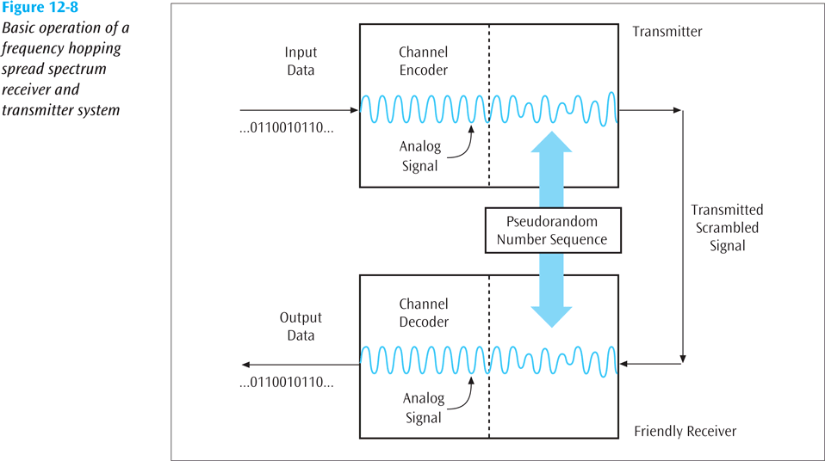
Spread Spectrum Technology (continued)
Data Communications and Computer Networks: A Business User's Approach, Eighth Edition
© 2016. Cengage Learning. All Rights Reserved.

Slide 54
Spread Spectrum Technology (continued)
Direct sequence spread spectrum
  This technology replaces each binary 0 and binary 1 with a unique pattern, or sequence, of 1s and 0s
  For example, one transmitter may transmit the sequence 10010100 for each binary 1, and 11001010 for each binary 0
    Another transmitter may transmit the sequence 11110000 for each binary 1, and 10101010 for each binary 0
Data Communications and Computer Networks: A Business User's Approach, Eighth Edition
© 2016. Cengage Learning. All Rights Reserved.

Slide 55
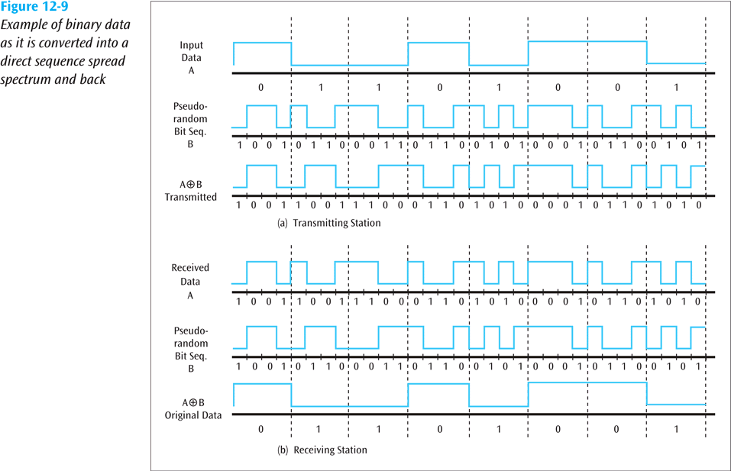
Spread Spectrum Technology (continued)

Slide 56
Guarding Against Viruses
Signature-based scanners look for particular virus patterns or signatures and alert the user
Terminate-and-stay-resident programs run in the background constantly watching for viruses and their actions
Multi-level generic scanning is a combination of antivirus techniques including intelligent checksum analysis and expert system analysis
Data Communications and Computer Networks: A Business User's Approach, Eighth Edition
© 2016. Cengage Learning. All Rights Reserved.

Slide 57
Firewalls
A system or combination of systems that supports an access control policy between two networks
Can limit the types of transactions that enter a system, as well as the types of transactions that leave a system
Can be programmed to stop certain types or ranges of IP addresses, as well as certain types of TCP port numbers (applications)
Data Communications and Computer Networks: A Business User's Approach, Eighth Edition
© 2016. Cengage Learning. All Rights Reserved.

Slide 58
Three Basic Types of Firewalls
Packet filter firewall – essentially a router that has been programmed to filter out or allow to pass certain IP addresses or TCP port numbers
Proxy server – more advanced firewall that acts as a doorman into a corporate network
  Any external transaction that requests something from the corporate network must enter through the proxy server
  Proxy servers are more advanced but make external accesses slower
Data Communications and Computer Networks: A Business User's Approach, Eighth Edition
© 2016. Cengage Learning. All Rights Reserved.

Slide 59
Three Basic Types of Firewalls (continued)
Application layer – inspects all packets coming into or leaving a connection using the application layer of the TCP/IP protocol suite
  Goes beyond IP addresses and TCP port numbers and inspects packet to see to which application it belongs
Data Communications and Computer Networks: A Business User's Approach, Eighth Edition
© 2016. Cengage Learning. All Rights Reserved.

Slide 60
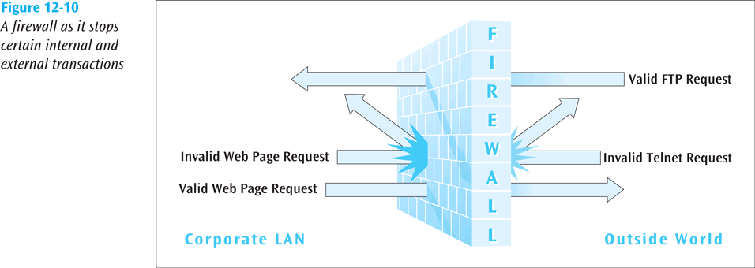
Firewalls (continued)
Data Communications and Computer Networks: A Business User's Approach, Eighth Edition
© 2016. Cengage Learning. All Rights Reserved.

Slide 61
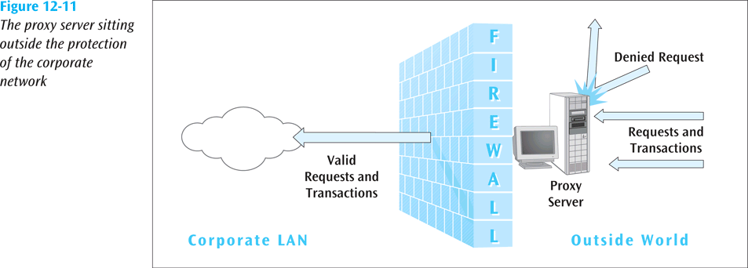
Firewalls (continued)
Data Communications and Computer Networks: A Business User's Approach, Eighth Edition
© 2016. Cengage Learning. All Rights Reserved.

Slide 62
Wireless Security
How do you make a wireless LAN secure?
  WEP (Wired Equivalency Protocol) was the first security protocol used with wireless LANs
    It had weak 40-bit static keys and was too easy to break
  WPA (Wi-Fi Protected Access) replaced WEP
    Major improvement including dynamic key encryption and mutual authentication for wireless clients
Data Communications and Computer Networks: A Business User's Approach, Eighth Edition
© 2016. Cengage Learning. All Rights Reserved.

Slide 63
Wireless Security (continued)
Both of these should eventually give way to a new protocol created by the IEEE
  IEEE 802.11i, or WPA2
WPA2 allows keys, encryption algorithms, and negotiation to be dynamically assigned
Also, AES encryption based on the Rijndael algorithm with 128-, 192-, or 256-bit keys is incorporated
Data Communications and Computer Networks: A Business User's Approach, Eighth Edition
© 2016. Cengage Learning. All Rights Reserved.

Slide 64
Security Policy Design Issues
What is the company’s desired level of security?
How much money is the company willing to invest in security?
If the company is serious about restricting access through an Internet link, what about restricting access through all other entry ways?
The company must have a well-designed security policy
Data Communications and Computer Networks: A Business User's Approach, Eighth Edition
© 2016. Cengage Learning. All Rights Reserved.

Slide 65
Network Security In Action:
Making Wireless LANs Secure
Recall Hannah the network administrator from Chapters Seven, Eight, and Nine – Now her company wants to add a wireless LAN to their system and make it secure
She needs to protect herself from war drivers
Should she use WEP?
What about Cisco’s LEAP (Lightweight Extensible Authentication Protocol)?
Data Communications and Computer Networks: A Business User's Approach, Eighth Edition
© 2016. Cengage Learning. All Rights Reserved.

Slide 66
Network Security In Action:
Making Wireless LANs Secure (continued)
What about WPA?
  If she decides to use WPA, where does she have to install the WPA software?
    In the user’s laptop?
    At the wireless access point?
    At the network server?
    All the above?
What about WPA2?
  Too new? Compatible software and hardware systems?
Data Communications and Computer Networks: A Business User's Approach, Eighth Edition
© 2016. Cengage Learning. All Rights Reserved.

Slide 67
Summary
Network security continues to be an increasingly important topic, particularly with increase in network interconnectivity
Two most common system attacks are:
  Socially engineered attacks
  Attacking known OS and application software vulnerabilities
Network personnel and users must take physical protection measures
Controlling access to computer system and its network is an essential aspect of network security
Data Communications and Computer Networks: A Business User's Approach, Eighth Edition
© 2016. Cengage Learning. All Rights Reserved.

Slide 68
Summary (continued)
Passwords and other ID systems are very common access-controlling security techniques
  Passwords can be stolen and used by unscrupulous parties
Most computer systems apply access rights to resources of the system and users
Software that conducts continuous audit of network transactions creates electronic trail that companies can use when trying to catch malicious users
Providing security for system data is just as important as securing the system itself
Data Communications and Computer Networks: A Business User's Approach, Eighth Edition
© 2016. Cengage Learning. All Rights Reserved.

Slide 69
Summary (continued)
Public key cryptography uses two keys
  One key to encode messages
  Second key to decode messages
Data Encryption Standard was created in 1977 and uses a 56-bit key to encrypt data transmitted between two business locations
Digital signatures use public key cryptography and can be used to verify that a given document belongs to given person
Pretty Good Privacy is free encryption software that allows regular users as well as commercial users to encrypt and decrypt everyday transmissions
Data Communications and Computer Networks: A Business User's Approach, Eighth Edition
© 2016. Cengage Learning. All Rights Reserved.

Slide 70
Summary (continued)
Kerberos is public or private key encryption technique that can be used by commercial application programs to verify that a user is who he or she claims to be
Public key infrastructure uses public key cryptography, digital signatures, and digital certificates to enable secure passage of data over unsecured networks
Steganography is study of hiding secret data within an unrelated document, for example, hiding bits of a message within pixels of an image
Along with securing network data, it is imperative to secure network communications
Data Communications and Computer Networks: A Business User's Approach, Eighth Edition
© 2016. Cengage Learning. All Rights Reserved.

Slide 71
Summary (continued)
In order to secure communications, network administrators and users must be aware of standard computer attacks and viruses that can damage computer systems
Another means of securing communications is a firewall, a system or combination of systems that supports an access control policy between two networks
Securing wireless networks is a new and exciting field of study
A proper network security design helps corporate network staff by clearly delineating which network transactions are acceptable
Data Communications and Computer Networks: A Business User's Approach, Eighth Edition
© 2016. Cengage Learning. All Rights Reserved.

